Slide 1
Project 1
Kevin Shaw
Brittany Butchkoski
Jennifer Hooker

Slide 2
Our Dataset – Employee Attrition & Factors
This dataset offers a comprehensive and varied analysis of an organization's employees, focusing on areas such as employee attrition, personal and job-related factors, and financials (Kaggle.com)
We chose to present an analysis on employee attrition. We will focus on three key points:
Job Role vs. Relationship status
Lack of growth in company within certain age groups
Attrition depending on frequency of travel

Slide 3
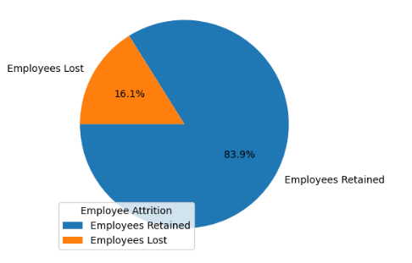
Attrition Overview
Our dataset presented a total of 1,470 emplolyees
1,233 of the employees have been retained
237 of the employees were lost

Slide 4
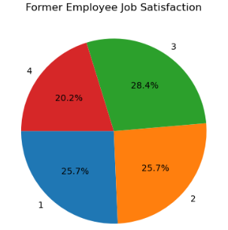
Former employee Satisfaction
1 – Least Satisfied
2 – Somewhat Satisfied
3 – More Satisfied
4 – Extremely Satisfied

Slide 5
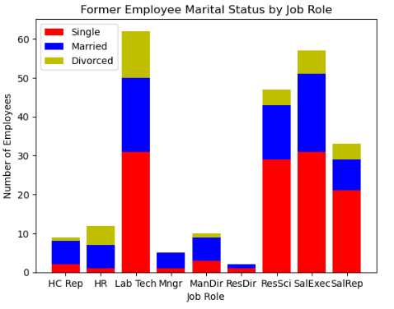
Job Role VS. relationship status
In the 4 job roles the highest number of employees resigning, single employees make up the largest group.
In the 5 job roles with stronger employee retention, married employees are the largest representation resigning.

Slide 6
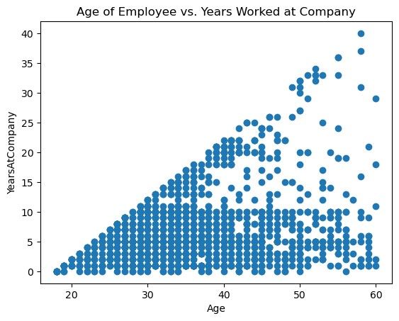
Scatter plot showing the ages of employee’s vs their tenure at the company. We found that short tenured employees were more likely to leave than lengthy tenured employees regardless of age.

Slide 7
Tenured Satisfaction
This chart displays that lowered tenured employees were more dissatisfied with the organization than higher tenured employees – correlates into the previous slide that younger less tenured employees were likely to leave.

Slide 8
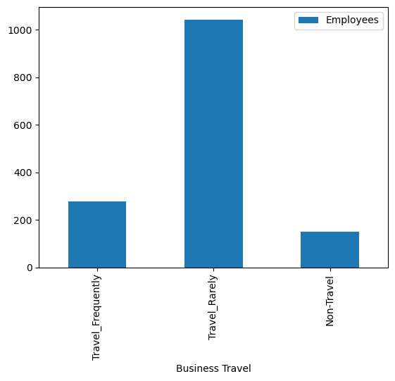
Travel Rate of employees
This bar chart represents the number of employees who travel. After analysis we have proven that more and those who travel less are more likely to stay with their company.

Slide 9
THANK YOU

